Slide 1
NON-INVASIVE MICROWAVE SENSOR SYSTEM FOR REAL-TIME GLUCOSE LEVEL DETECTION

Slide 2
Introduction
Effective management of blood glucose levels is crucial for individuals with diabetes.
It prevents serious complications such as heart attack, stroke, lower limb amputation, and kidney failure.
Glucose monitoring devices are used to monitor the glucose levels.

Slide 3
Existing problem
Most available glucose monitoring devices are invasive.
It involves painful and expensive finger-pricking procedures.
There is a growing need for non-invasive and pain-free biosensors for glucose monitoring.

Slide 4
Proposed solution
Microwave sensing techniques are promising for non-invasive glucose monitoring as they can provide information on biological tissues with minimal or no contact.
Microwaves can penetrate biological tissues without posing health risks, making them suitable for non-invasive monitoring.

Slide 5
RF-Based Sensor Design
The proposed RF-based sensor operates at a frequency range of 1 - 2 GHz for non-invasive blood glucose level measurements.
The sensor is composed of four Octagonal-shaped complementary split-ring resonators arranged in a honeycomb structure.
The design is sensitive to glucose samples at the level of interest, with a step resonance response of about -40 dB.

Slide 6
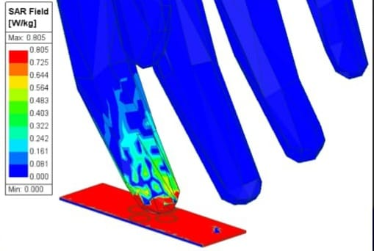
Simulation
Ansys Hfss is used for modelling and 3D electromagnetic simulations of the microwave sensor with a human fingertip inserted in the sensing region.
The simulations consider different finger layers' thicknesses, such as skin, fat, blood, and bone, and their influence on the microwave sensor.

Slide 7
Evaluation
Bio-impedance measurements are used for glucose monitoring, evaluating changes in blood impedance during the cardiac cycle.
The study focuses on removing tissue influence on blood glucose concentration to enhance measurement accuracy.

